Slide 1

SafeShipping
SMART CONTRACTS ENABLED

Slide 2
SafeShipping
Secure
Transparent
Automated
National

Slide 3
Problem #1
🚛 1. The Fragmented US Carrier Ecosystem: Carriers span multiple tiers:
Carrier Type | Examples | Challenge
National | UPS, FedEx, USPS | Centralized, but opaque tracking
Regional | LaserShip, OnTrac | Limited traceability between zones
Final Mile / 3PL | Local subcontractors, gig apps | No contract accountability or fraud control
Commercial Freight | Schneider, XPO, C.H. Robinson | Dispute-prone contract enforcement

Slide 4
Problem #2
📦 2. Key Distribution Challenges
Issue | Description
Lack of trust in final mile | Misdeliveries, false "delivered" claims, no on-chain proof
Delayed or partial deliveries | Especially for LTL (Less Than Truckload) — hard to verify load integrity
Disputes over condition | Commercial freight claims due to damage — no trusted sensor data
Multi-party complexity | Shippers, receivers, brokers, and carriers have separate systems & incentives
Insufficient automation | Most shipping triggers are manual or based on carrier APIs, not verifiable data

Slide 5
Solution
🧠 3. SafeShipping Smart Contract Applications (US Market)
Feature | Implementation | Value
Delivery Confirmation NFT | Token minted at contract creation; burned/updated upon GPS + IoT validation | Trustless proof of delivery
IoT Condition Verification | GPS, temp, shock sensors → Chainlink oracle triggers | Prevents disputes + automates insurance
Escrow-based Carrier Payouts | Smart contract holds funds until milestones met | Incentivizes performance + compliance
Multi-party Dispute Handling | On-chain arbitration contracts w/ evidence logs | Efficient, programmable resolution

Slide 6
Where We Are Today
🔁 4. Real-World US Use Cases
Participants | The Problem | The Solution
🚛 Final Mile Network Delivery (e.g., Amazon, DoorDash Logistics) | False delivery scans, porch theft claims | Geofenced smart contracts w/ real-time validation via phone/IOT
🏢 B2B Warehousing & Fulfillment (e.g., Shopify, Flexe, Micro-fulfillment) | Lack of shared tracking standard across partners | Unified, tokenized shipment record w/ access roles
🧊 Cold Chain Pharma / Food Distribution (e.g., McKesson, Blue Apron) | Disputes over spoilage, chain-of-custody violations | Sensor-linked escrow — release only if temp and route conditions met

Slide 7
How It Works
IoT + Chainlink oracles trigger smart contracts on:
Carrier Pickup
Route Tracking
Delivery confirmation
NFT delivery confirmation = transfer of ownership.

Slide 8

Ecosystem Advantage
Arbitrum: Low gas, fast EVM
Chainlink: Real-time oracles
Polygon: NFT infra
Solana: Real-time sensor updates
Gitcoin: Open-source funding

Slide 9

Technology Stack
Smart Contracts: Solidity, Rust
Oracles: Chainlink
App: React + Next.js
NFTs: ERC-721

Slide 10
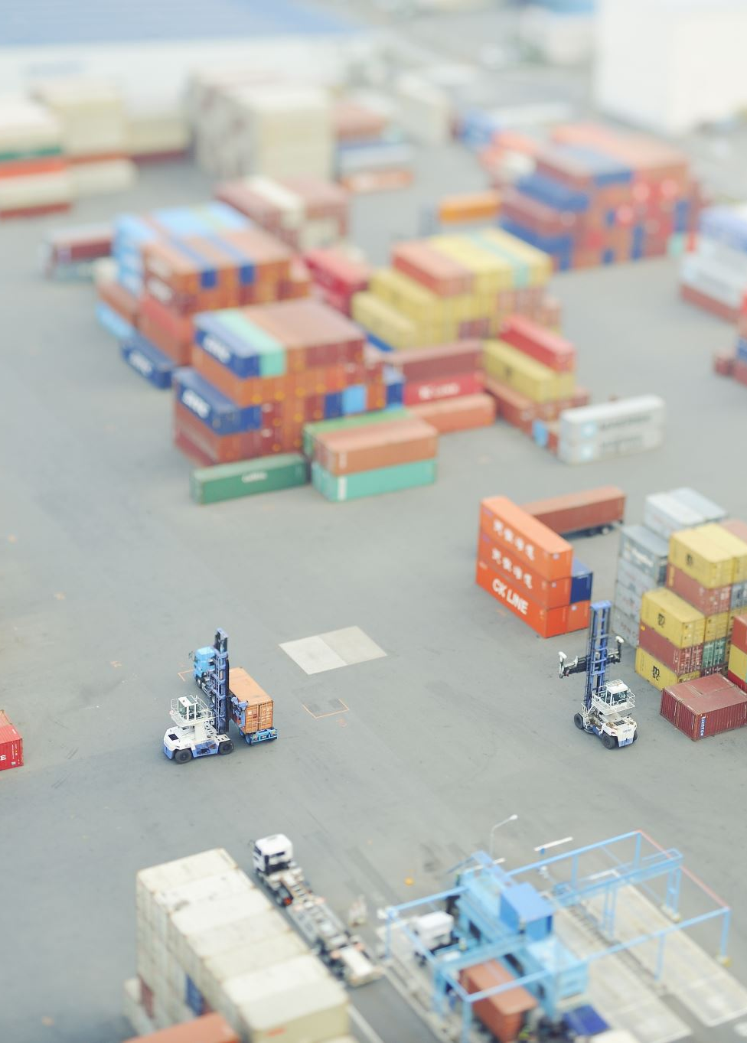
Business Model
🎯 Core Offering
Smart-contract logistics protocol using IoT + blockchain enables:
Trusted delivery
Real-time milestone tracking
Automated payments

Slide 11
Projected Revenue Streams
Revenue Stream | Description | Example Clients
B2B SaaS Licensing | Monthly fee for access to API + dashboard for logistics firms | 3PLs, regional carriers, brokers
Per-Transaction Fees | Small % cut per shipment tracked + verified via smart contract | Final-mile partners, USPS API
Custom Integration Fees | One-time charge for Oracle/IoT custom integrations into ERP systems | Fulfillment centers, freight
Data/Insights Licensing | Aggregated, anonymized shipment performance + risk analytics | Insurers, risk managers, DOT
NFT Document Issuance | Fee per tokenized bill of lading, customs doc, or proof of delivery NFT | Freight forwarders, importers

Slide 12
Market Estimates (US-Focused)
📦 US Parcel + Freight Volume (2024–25)
Segment | Volume (2024 est.) | TAM Estimate
Final Mile Delivery | 21 billion parcels/yr | $110B+ in shipping fees
LTL Freight | 180M shipments/yr | $70B market
Full Truckload | 400M+ loads/yr | $180B market
Cold Chain Logistics | $22B market (2025) | High-value IoT use
Total Addressable Market (TAM): $350B+ in verifiable US shipment volume Initial Target Market (SAM): ~$2B B2B/enterprise clients handling >10k/mo shipments Serviceable Obtainable Market (SOM): ~$100M over 3–5 years with 50 key partners

Slide 13
Impact
📈 Tangible Impact Metrics (Modeled)
Metric | Est. Impact (5-Year View)
Dispute resolution reduction | -60% for verified contracts
Delivery fraud reduction | -40% in false “delivered” scans
Smart contract adoption | 5M+ contracts executed in 3 years
Customs clearance time saved | 20–40% faster for international cargo
Insurance claims automated | $100M+ in reduced payout friction

Slide 14

Roadmap
MVP → Customs pilot → Oracle integration
NFT docs → DAO for dispute standards
Multi-chain rollout

Slide 15
Why Now?
📈 5. Why This Matters Now (2025+)
Retail giants are vertically integrating logistics
The White House Supply Chain Strategy emphasizes resilience + tech adoption
Grant + innovation funding from DOT, NSF, and logistics think tanks are rising
Can qualify for NSF + DOT SBIR innovation grants in logistics + automation
Plug into US Department of Transportation’s digitization initiatives
Blockchain-based provenance is increasingly required in pharma, perishables, and high-value electronics

Slide 16
The Ask
Grants + support per ecosystem
Join our mission to automate national logistics

